Slide 1
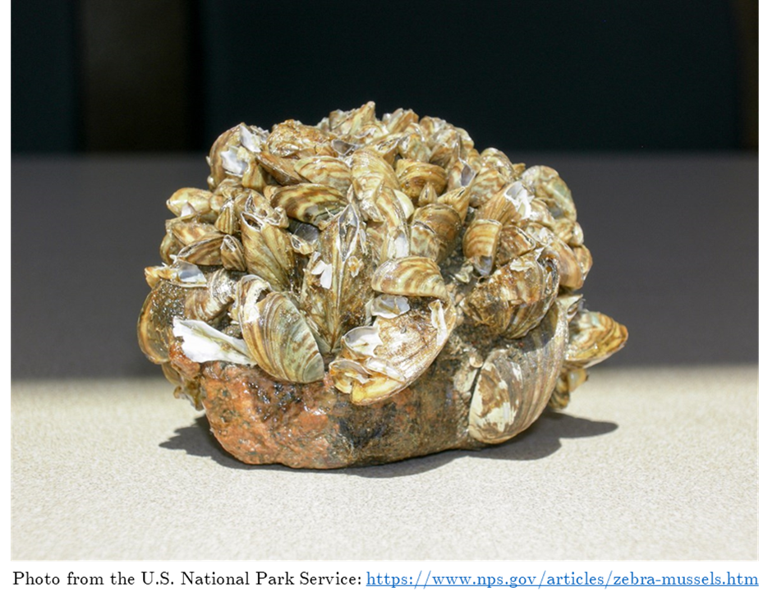
Occupancy Data
Presence or absence data
Non-zero probability of a false-negative result
Occupancy models
Estimation of occupancy while accounting for errors in detection
Need replication

Slide 2
eDNA Surveys
Plankton Tow Surveys
Lake
Lake
Sample Site
…
Sample Site
Sample Site
…
Sample Site
Plankton Tows
Plankton Tows
Sample
…
Sample
Sample
…
Sample
Microscopy
Microscopy
…
…
…
…
PCR replicate
PCR replicate
PCR replicate
PCR replicate
PCR replicate
PCR replicate
PCR replicate
PCR replicate

Slide 3
Lake
Sample Site
…
Sample Site
Sample
…
Sample
Sample
…
Sample

